Slide 1
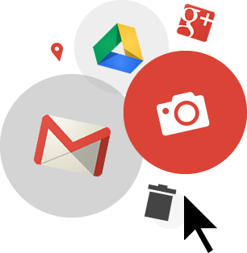
How to Create a
Google Account

Slide 2
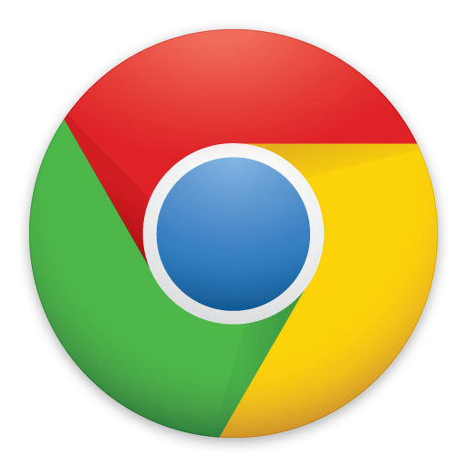
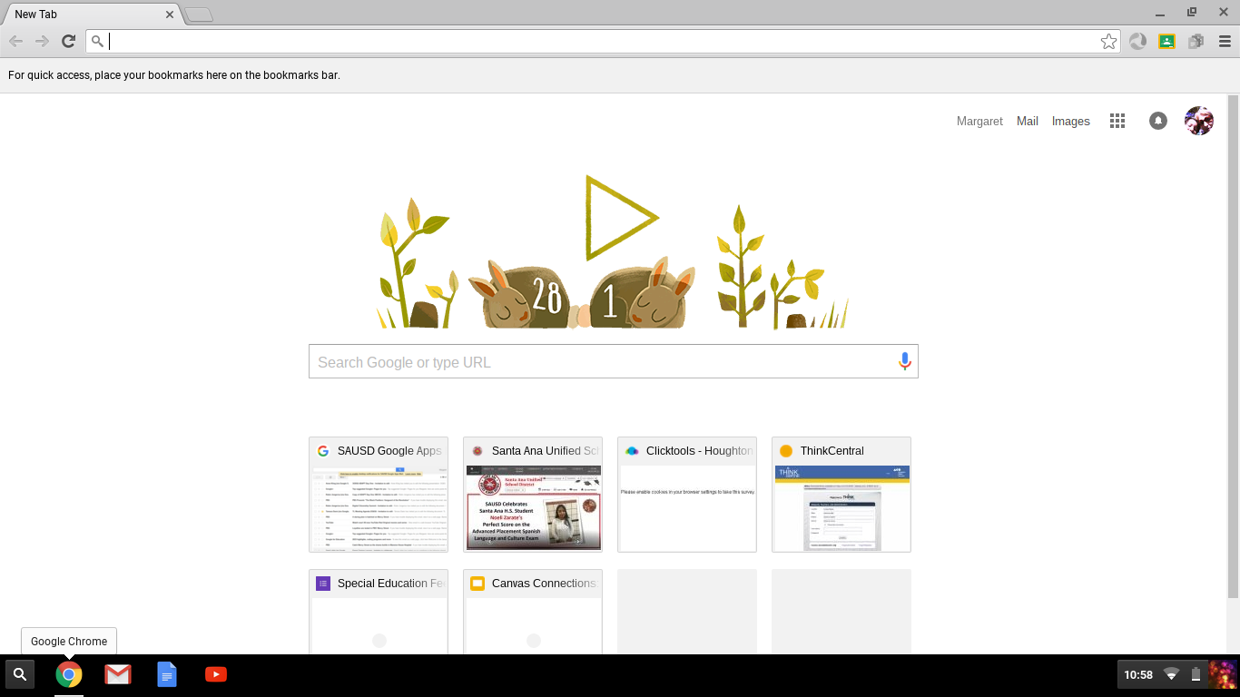
Let’s sign up!
You will only need to do this once.
With your mouse, double click the Chrome icon in the lower right hand corner to open Google.
In the address bar type type https://accounts.google.com/signup and press the Enter key on your Chromebook.
      * Para las instrucciones en Español https://goo.gl/PzTP1y
Notes:
Instructor: Make sure each student is able to get to Chrome and find this button. Be sure they know NOT to add www before the word “accounts”.

Slide 3
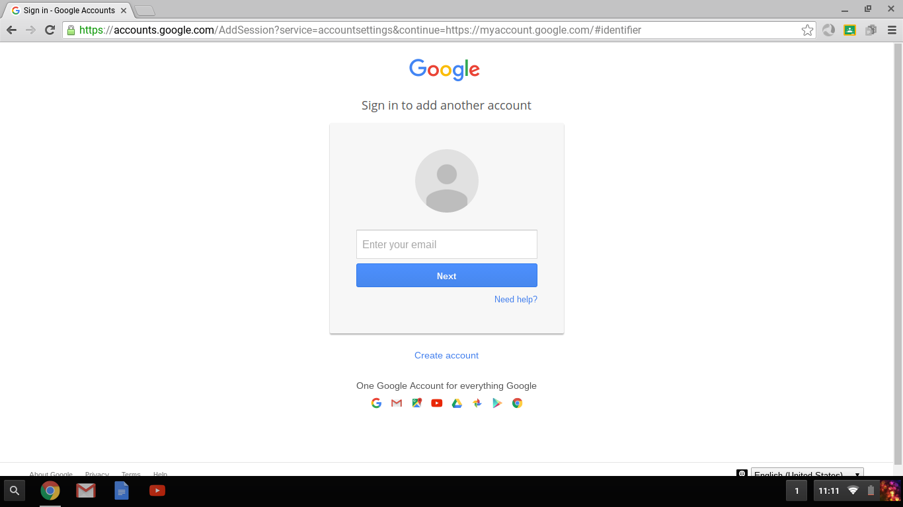
Let’s sign up!
Click Create account

Slide 4
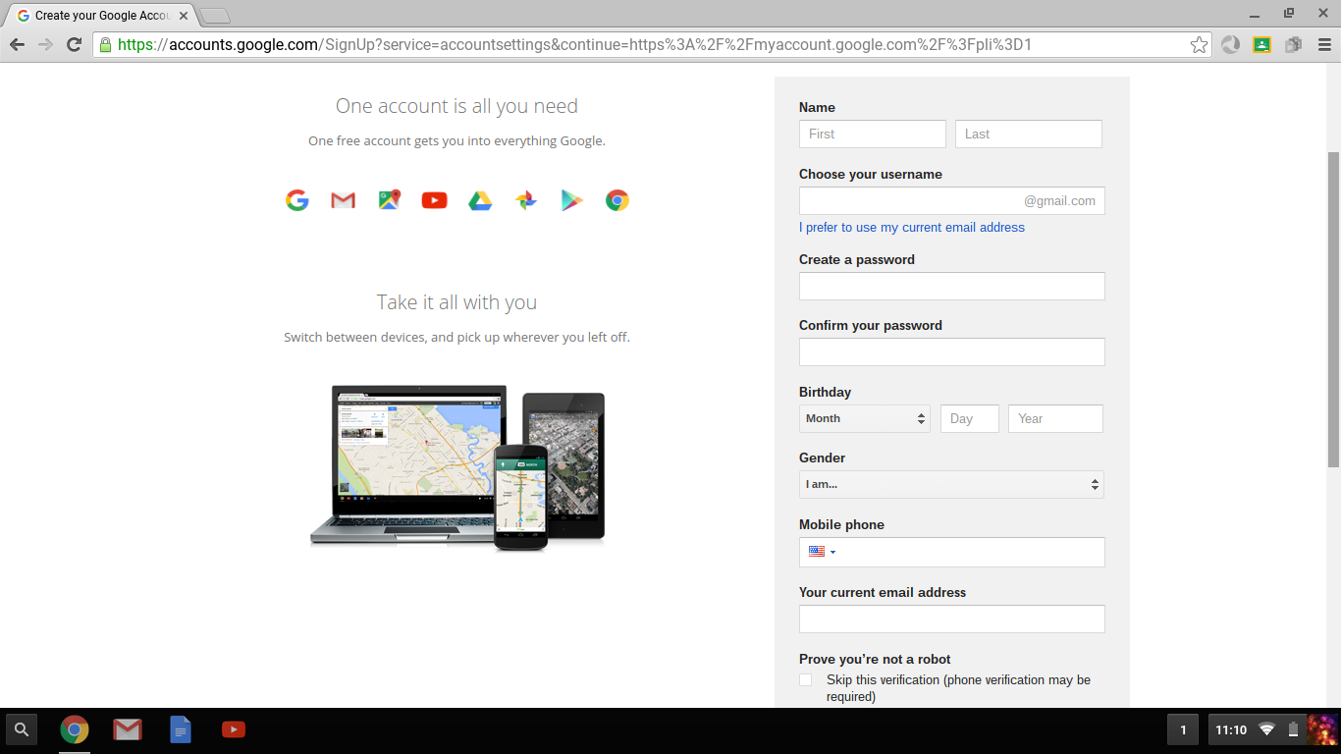
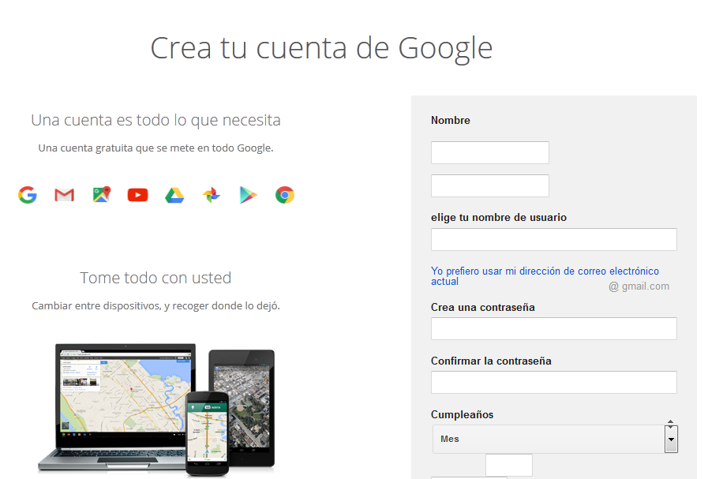
This is what you will see
English instructions
https://accounts.google.com/signup
Las Instrucciones en Español
https://goo.gl/U5hx6H

Slide 5
Enter your information
Type your first and last name
Create your username with your first and last name.
  If this username is not available, try using your initials, middle name, or a nickname (though keep it memorable and professional).
  For example: mariacgonzalez OR gonzalezmaria OR mcgonzalez
Create a password that you will remember, enter it again.
Select your birthday and gender
Enter your Mobile phone number (optional)
Enter your current email address (optional)
Notes:
Instructor: Be sure to have students complete all these steps before you move to the next slide. If some are having trouble, have them help each other.

Slide 6
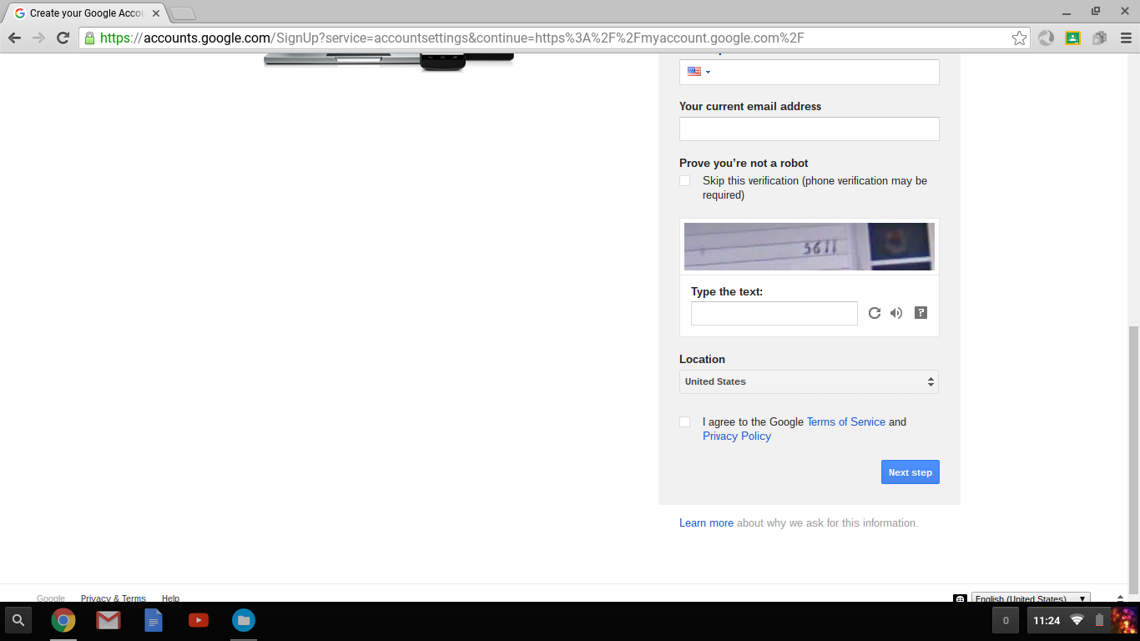
Almost done...
Prove you are not a robot!
Put your mouse cursor in the Type the text box and type the number you see in the picture.
Click in the box to agree to Google terms of service
Click
Click Continue on the next page
Next step
Notes:
Instructor: Be sure all students advance to the Next step and have clicked Continue

Slide 7
Write down your information
Write down your username, password, and gmail address (username@gmail.com)
For example:
Username = fredmaciasgodinez
Password = Santaana2016
Gmail address= fredmaciasgodinez@gmail.com
Username:
Password:
Gmail address:

Slide 8
You’re done!
Close the account setup pages by selecting the X icon in the upper right hand corner of your screen
In the lower right corner, click Guest
In the box that opens, select Exit Guest if necessary

Slide 9
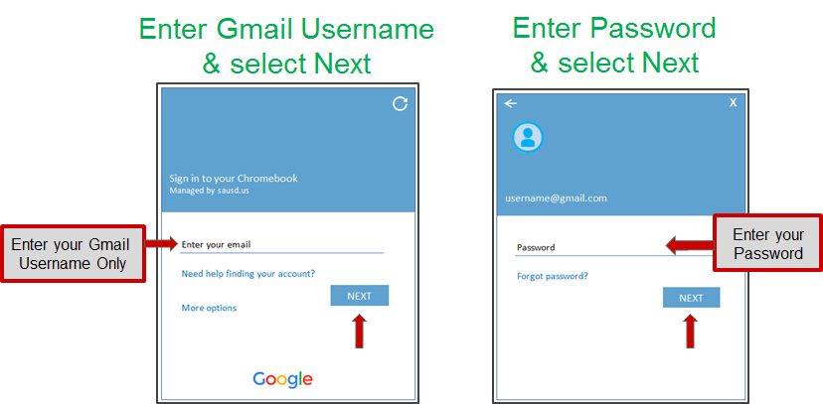
Sign in to your Chromebook
Using your Google Account
You will need your Google email (Gmail) username and password.
Enter your Google Email (Gmail) username & Password.

Slide 10


